Slide 1

HTCS6706 Data Analysis Part 3: Presentation
By Young Kwang Kweon (1605812)

Slide 2

Project Overview
Problem: Phishing is a major cybersecurity threat, using fraudulent websites to steal user data
Aim: Use data analysis and machine learning to identify, understand, and predict phishing attacks.
Dataset: 11,055 websites, 30 structural attributes

Slide 3
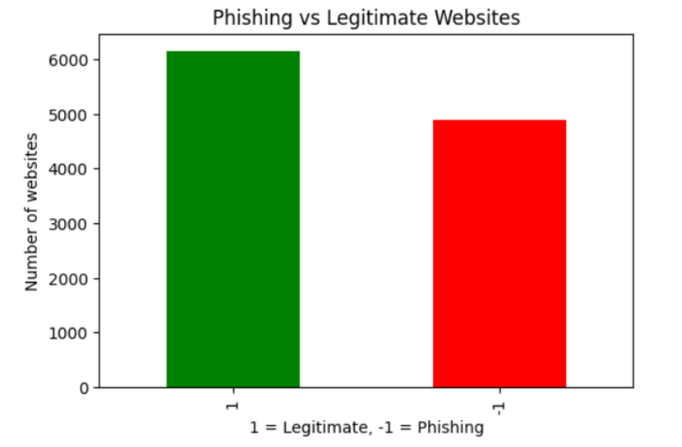
The Dataset
44% (4,898) phishing, 56% (6,157) legitimate websites (moderately balanced)
Features: 30 web attributes (e.g., SSL status, URL structure, anchor tags)
Each attribute: flagged as phishing (-1), suspicious (0), legitimate (1)

Slide 4

Cybersecurity Questions
What are common features of phishing websites?
Which patterns or correlations help distinguish phishing from legitimate sites?
Can machine learning models accurately predict phishing sites?

Slide 5
Analysis Process
Descriptive Analysis: Statistical summaries (mean, median, mode, ranges, etc.)
Exploratory Analysis: Visualizations (bar charts, boxplots, histograms, heatmaps, scatter plots, pie charts)
Predictive Analysis: ML models (Logistic Regression, Decision Tree, Random Forest)

Slide 6
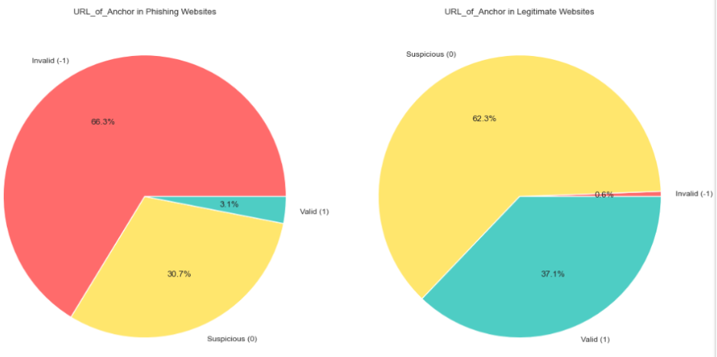
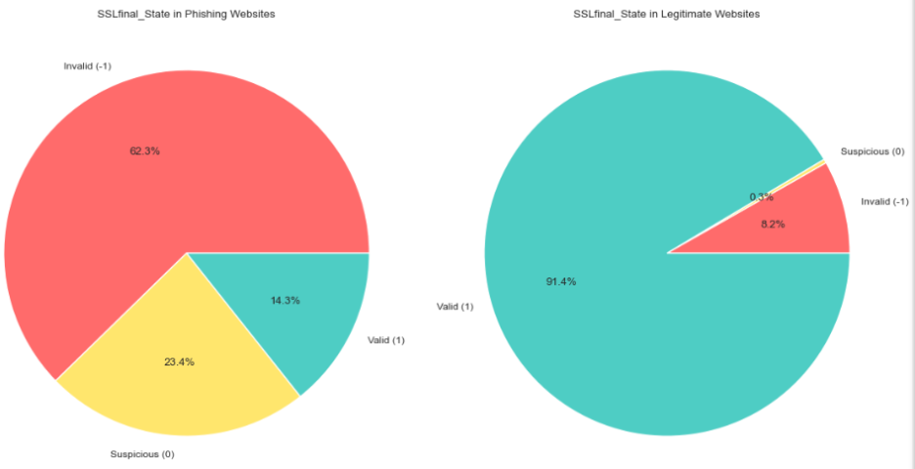
Key Findings: Descriptive & Exploratory
SSLfinal_State
SSLfinal_State and URL_of_Anchor are the most powerful predictors.
Phishing Sites: 62.3% have Invalid SSL certificates.
Legitimate Sites: 91.4% have Valid SSL certificates.
Phishing Sites: 66.3% have Invalid/Suspicious anchor links.
Legitimate Sites: Only 0.6% have invalid links; most are valid or suspicious (internal).
URL_of_Anchor

Slide 7
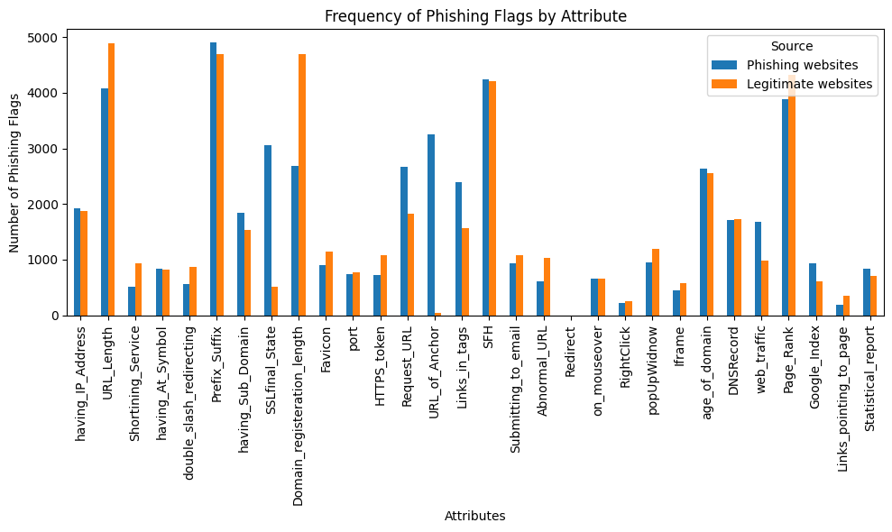
Visual Highlights: Bar chart
Top phishing indicators: SSLfinal_State and URL_of_Anchor

Slide 8
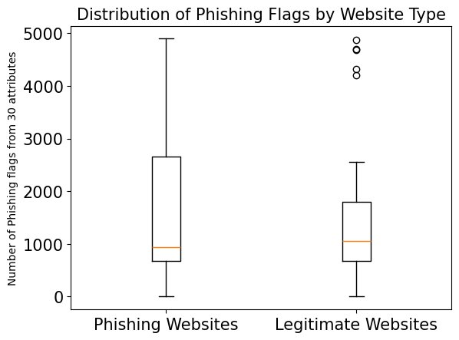
Visual Highlights: Boxplot
Phishing flags spread wider in phishing sites

Slide 9
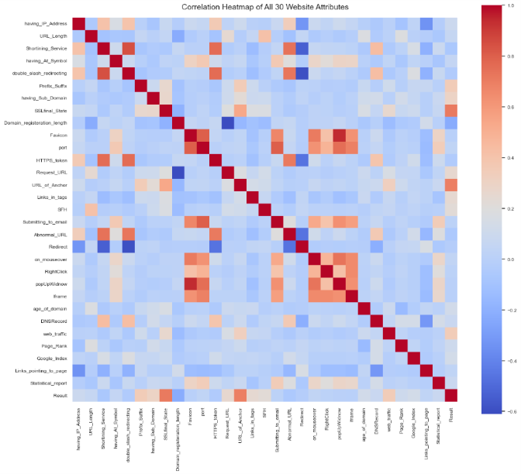
Visual Highlights: Heatmap
SSLfinal_State and URL_of_Anchor show strong correlation with “Result” (site type)

Slide 10
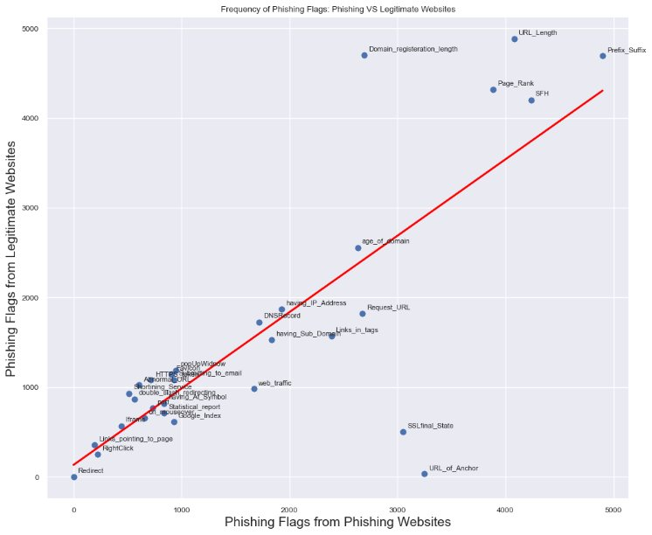
Visual Highlights –Scatter plot
SSLfinal_State and URL_of_Anchor strong correlation with “Result” (site type)

Slide 11
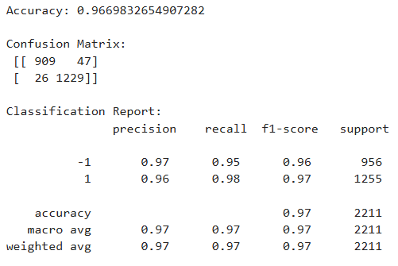
Predictive Model Comparison
All models work well; random forest is best.
Top features are consistent across models.
The model confirms our findings: SSL and Anchors are most important.
Results from Random Forest
Model | Accuracy | Key Features
Logistic Regression | 92.4% | URL_of_Anchor, Prefix_Suffix, SSLfinal_State
Decision Tree | 92.5% | SSLfinal_State, URL_of_Anchor
Random Forest | 96.7% | SSLfinal_State, URL_of_Anchor, web_traffic

Slide 12
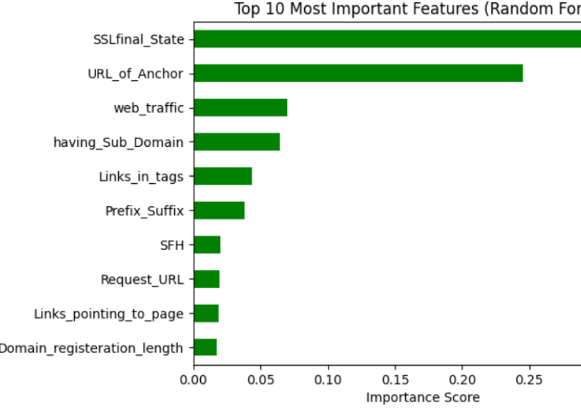
Random Forest Results
SSLfinal_State: #1 most important feature for the model.
URL_of_Anchor: #2 most important feature

Slide 13
Recommendations
Prioritise SSL validation and anchor link analysis in automated detection.
01
Use ensemble Machine Learning models (random forest) for best results in real-world phishing detection.
02
Implement regular monitoring of top indicators to strengthen web security.
03

Slide 14
Conclusion
Phishing sites are defined by invalid SSL, suspicious anchor links, and long URLs
SSLfinal_State and URL_of_Anchor were consistently the strongest indicators across all analyses.
Random Forest model can automate detection with 96.7% accuracy, providing a powerful tool for mitigating phishing attacks.

Slide 15
Resources and References
Dataset source:
Mohammad, R., & McCluskey, L. (2015, March 25). Phishing Websites. UC Irvine. Retrieved from https://archive.ics.uci.edu/dataset/327/phishing+websites
Tools:
Jupyter Notebook: https://jupyter.org/
References:
Cote, C. (2021, October 26). WHAT IS PREDICTIVE ANALYTICS? 5 EXAMPLES. Harvard Business School Online. Retrieved from https://online.hbs.edu/blog/post/predictive-analytics
Kumar, A. (2023, January 13). Data Variables Types & Uses in Data Science. Analytics Yogi. Retrieved from https://vitalflux.com/data-variables-types-uses-in-data-science/
Villegas, F. (n.d.). Descriptive Analysis: What It Is + Best Research Tips. QuestionPro. Retrieved from https://www.questionpro.com/blog/descriptive-analysis/
What is exploratory data analysis (EDA)? (n.d.). IBM. Retrieved from https://www.ibm.com/think/topics/exploratory-data-analysis

